Slide 1
Natural Language Interactions with Visualizations
Notes:
Thanks x for the nice intro…
I am really glad to be here to share my work on visual text analytics…

Slide 2
Why Natural Language Interaction With Visualizations
Language and Vision are two powerful complementary communication channels for human
We aim to combine Information Visualization and Natural language to make data analytics accessible for everyone
e.g. people with low visualization and analytic skills could express their information needs using natural language

Slide 3
How to Integrate Natural Language with Visualizations?
Natural Language as input
A question about chart as input
Natural Language as output
e.g. chart summaries

Slide 4
Natural Language as Input
What?
Take question or request from users about charts and respond in the form of text and/or changes in visualizations
Why?
Reduce time and mental efforts for analytics
Lower the threshold of ability required to analyze data using visualizations
Notes:
enable people who have not been formally trained in data analysis tools and who do not have much visualization literacy to get answers to their questions as they can easily express their information needs in lay language

Slide 5
Natural Language as Output
What?
Use natural language to
explaining key points in charts
Explain how the model computes the answer
Enhance the transparency of the algorithm
Why?
Help explaining patterns, trends and outliers in charts that would otherwise may not be possible with charts only

Slide 6
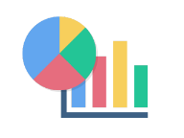





NL with Visualizations: Downstream Tasks
/
Text summary
Text
- Numbers/words as answer (factoid q/a)
- Explain how the model computes the answer.
- Text as answer (query focused summarization)
/
Single question/
Conversational qa/
Multimodal (e.g. speech, touch)
and/or
Viz and/or text
Visual story
Input
Output

Slide 7
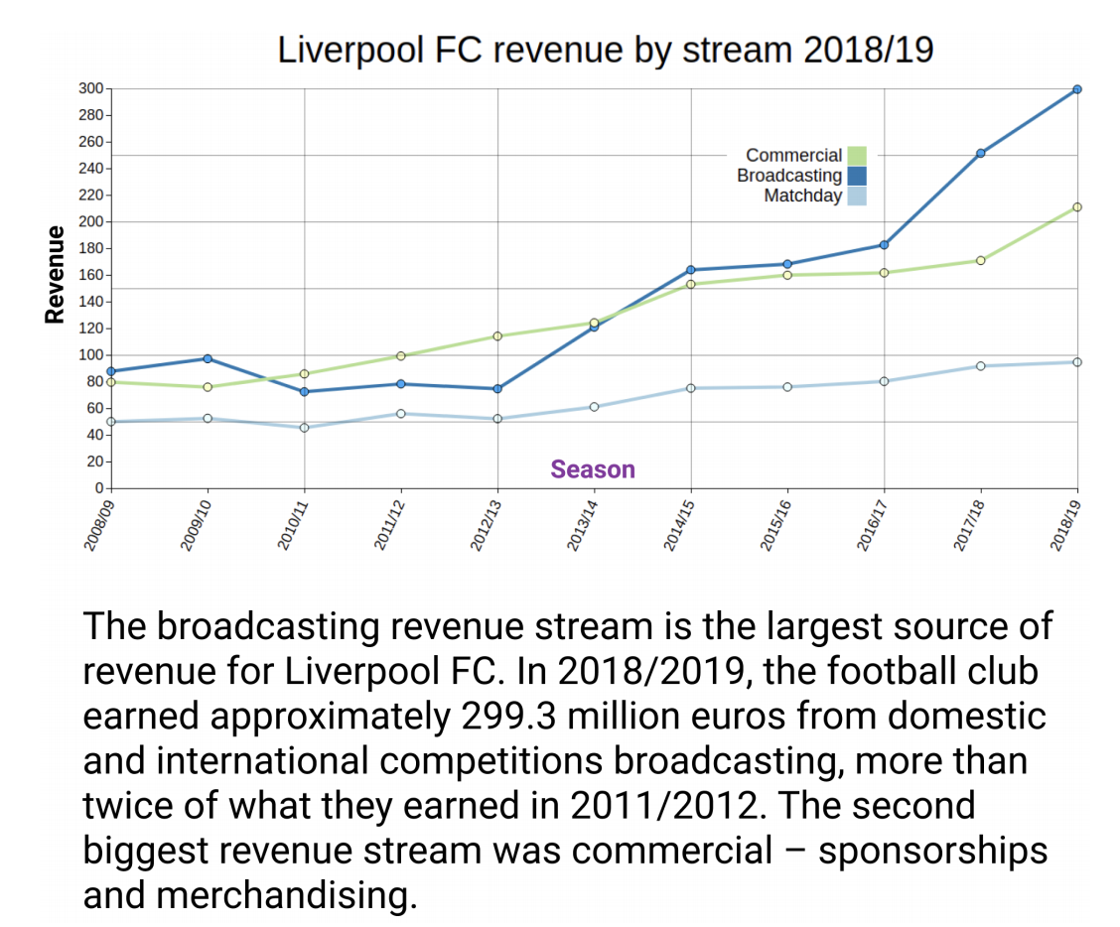
Task 1: Chart Summarization
Explain what the chart represents
Explain the patterns, trends and outliers in the charts
/
Text summary
Jason Obeid, and Enamul Hoque, Chart-to-Text: Generating Natural Language Descriptions for Charts by Adapting the Transformer Model, INLG 2020

Slide 8
Task 2: Factoid Question Answering
Lack of dataset
Most are synthetic, templated questions
Do not contain many examples of compositional question involving multiple arithmetic/logical operations
Lack questions with visual references
E.g. what is the longest bar?
Accuracy is usually low
Models have limited number of outputs

Slide 9
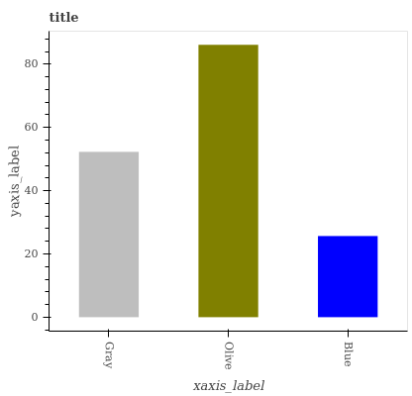
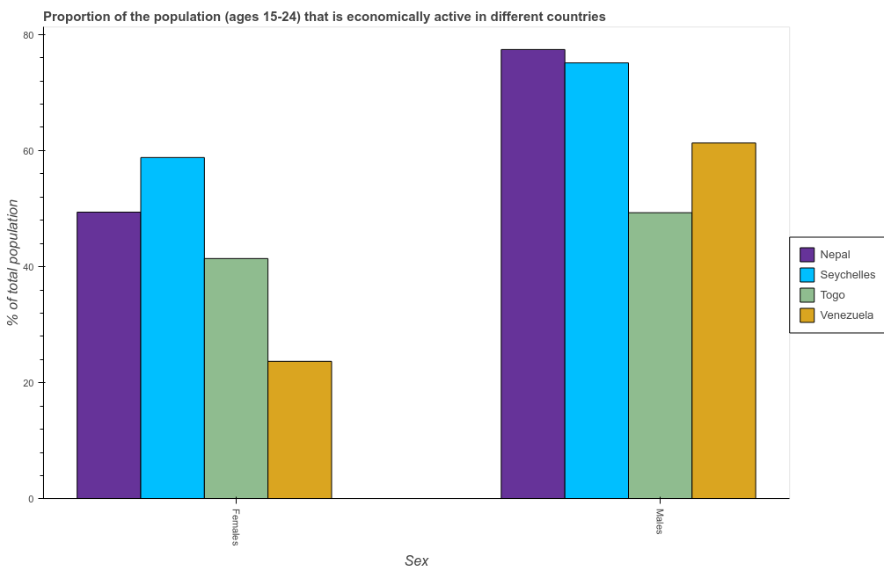
Task 2: Factoid Question Answering
Sample tasks:
Question: Is blue larger than Olive?
Question: What does the first color from the left in each group represent?
Answer: No
Answer: Nepal
Question: Which label has the smallest value?
Question: What’s the total population proportions of Nepal in the graph?
Answer: Blue
Answer: 120

Slide 10
Existing Datasets
 | DVQA | Figureqa | Leafqa/++ | Kim et al. | PlotQA
Chart Types | Bar | VBar, HBar, Line, dot line, and pie | Stacked, grouped, horizontal and vertical Bars. Line, pie, box plots, and scatter charts | Line/Bar | Vbar, Hbar, line and dot line
Question Types | Template-based | Template-based | Template-based | Human Generated | Template-based
Answers Types | 1076 Unique answers (Yes/No, Chart Vocabulay, ..) | 2 Yes/No | 75 (Yes/No, Chart Vocabulay, ..) | Unlimited | Unlimited (Fixed and Open Vocab)
Real/Synthetic | Syntehtic | Synthetic | Synthetic | Real | Synthetic
Size | 300K images | 100K images 1.5M QA pairs | 200K images 1.5M QA pairs | 52 Charts 600~800 QA pairs. | 28M QA pairs
Overall limitations:
1- Synthetic Charts
2- Template-based Questions and limited answers (Is X larger than Y?)
3- Lack of Lexical varations

Slide 11
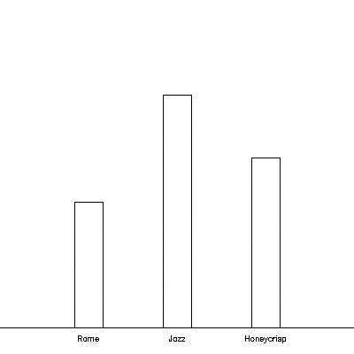
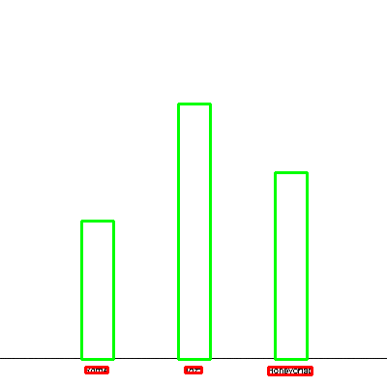
Task 2: Factoid Question Answering
VisionTapas
VL-T5
Overall Pipeline Architecture
Chart Image
Data Extraction
1) Question
Model
263
What is the sum of values for Jazz and Honeycrisp?
192
Final Answer
Sum(263, 192) = 455
142
2) Data Table
Variety | Value
Rome | 142
Jazz | 263
Honeycrisp | 192
3) Extracted Image Features with CNN/MaskRCNN

Slide 12
Model Plan
VisionTapas
Fixed Vocab Questions
Image Features
ViT
Cross-Attn
Classification Layer
Data Table
TAPAS
Question
Classifier
Open Vocab Questions
Data Table
TAPAS
Numeric Answer
VL-T5
Image Features
Encoder
Decoder
Data Table
Textual Answer
Question

Slide 13
Dataset Plan
Crawl real-world charts from different online sources such as Statista, OWID, OECD, and Pew.
Ask crowd workers through AMT to generate real-world QA pairs
Focus on compositional and visual questions
Two questions per chart
Collect around 10K Q/A pairs for 5K Charts
Augment the dataset with 5k-10k Q/A pairs generated from Statista summaries.

Slide 14
Task 3: Query Focused Summarization
Take a question as input and generate explanatory text that answers the question
Can be extractive, abstractive or grounded on the relevant paragraphs.
No existing dataset
@Shankar: Please add
- sample q/a,
- our plan for dataset including annotation process
- list of possible baseline models

Slide 15
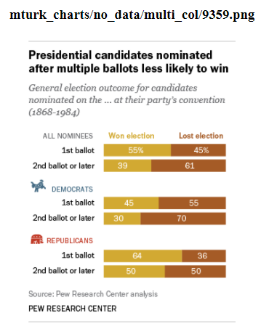
Cannot Create Open Ended Question
A contested convention, for those who’ve never experienced one (which is to say, everyone under the age of 35 or 40), occurs when no candidate has amassed the majority of delegate votes needed to win his or her party’s nomination in advance of the convention. A candidate still might gather the delegates needed by the time balloting begins, in which case the nomination is settled on the first ballot. But should the first ballot not produce a nominee, most delegates become free to vote for whomever they wish, leading potentially to multiple ballots, horse-trading, smoke-filled rooms, favorite sons, dark horses and other colorful elements that have enlivened American political journalism, literature and
(cannot create open ended question since there is no reference to the data in the chart.)

Slide 16
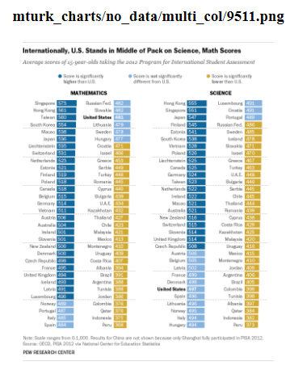
Cannot Create Open Ended Question
Fact Tank’s look at standardized test results around the world seemed to bear out these sentiments: U.S. students are improving – slowly – in math and science, but still lagging their peers internationally.
(cannot create open ended question since summary doesn’t reference any information in chart.)

Slide 17
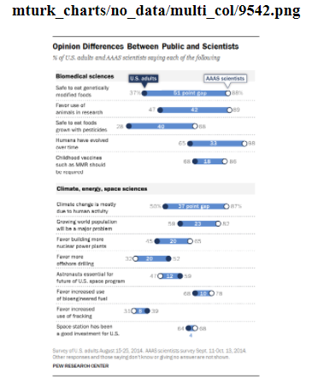
Cannot Create Open Ended Question
Scientists and the American public are often far apart when it comes to views about science-related issues. Members of the science community, for example, are much more likely to say genetically modified foods and foods grown with pesticides are safe to eat, and that climate change is mostly due to human activity, according to our recent survey of U.S.-based members of the American Association for the Advancement of Science. A global median of 54% consider climate change a very serious problem, according to our survey of 40 nations. But there are regional differences on views of climate change, with people from Latin America and Africa expressing more concern than others. Before delegates from 195 nations approved a landmark climate accord in Paris this year to limit carbon emissions, our spring survey found a median of 78% supporting such a deal.
(cannot create open ended question since values mentioned in summary cannot be derived from data shown in chart.)

Slide 18
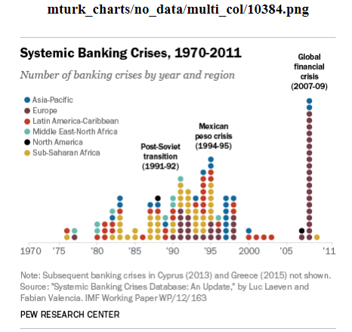
Too Complex
We examined a comprehensive database of financial crises from 1970 through 2012 compiled and maintained by two economists for the International Monetary Fund to see just how unusual the current situation in Greece is. The IMF economists defined “systemic banking crises” as those with both “significant signs of financial distress in the banking system,” such as major bank runs, losses and liquidations, and significant policy interventions in response, such as deposit guarantees, nationalizations, recapitalizations, deposit freezes and bank holidays.
(too complex since bars have no axis labels and is in unconventional format .)

Slide 19
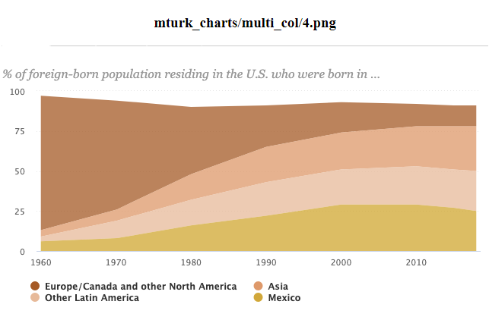
Too Complex
The regions of origin for immigrant populations residing in the U.S. have dramatically shifted since the passage of the 1965 Immigration and Naturalization Act. In 1960, 84% of immigrants living in the U.S. were born in Europe, Canada or other North American countries, while only 6% were from Mexico, 4% from Asia, 3% from the rest of Latin America and 3% from other areas. Immigrant origins now differ drastically, with European, Canadian and other North American immigrants making up only a small share of the foreign-born population (13%) in 2018. Asians (28%), Mexicans (25%) and other Latin Americans (25%) each make up about a quarter of the U.S. immigrant population, followed by 9% who were born in another region.
(too complex since area charts are difficult to extract values are particular time periods.)

Slide 20
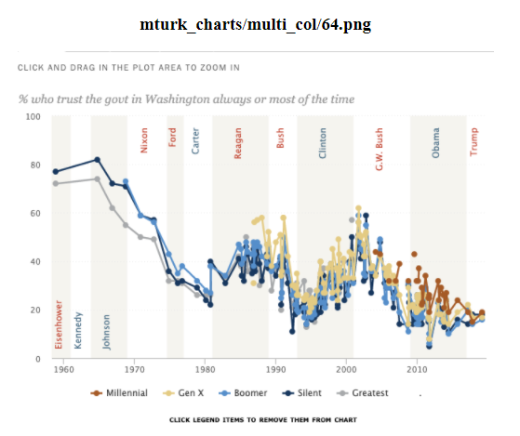
Too Complex
Historically, there have been modest differences between generational groups in trust in government and that remains the case today. Currently, 19% of Millennials (now ages 23-38) report trusting the government, similar to the shares of older generations who say the same. Trust in government remains at or near historically low levels across generational lines.
(too complex since the line charts are difficult to seperate.)

Slide 21
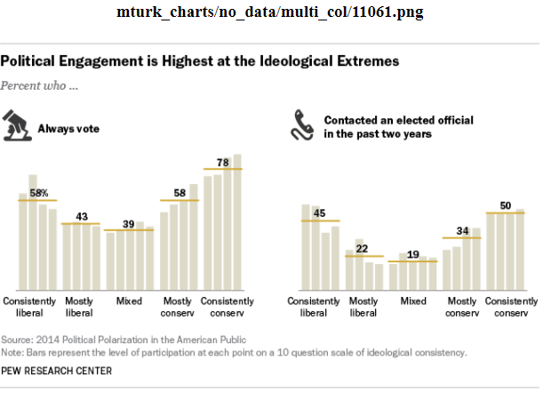
Too Complex
Last year’s series of Pew Research Center reports on political polarization used a 10-item scale of ideological consistency to place Americans into five categories: consistently conservative or liberal, mostly conservative or liberal, and mixed. By that metric, 9% of the public overall is consistently conservative, including 20% of Republicans and Republican leaners; most of the remaining Republicans and leaners were “mostly conservative” (33%) or had a mixture of liberal and conservative views (37%). Consistent conservatives participate in politics at higher rates than most other ideological groups. Political engagement tends to be highest among the most consistent conservatives and liberals, the Pew Research survey found. Half of consistent conservatives, for example, said they had contacted an elected official within the past two years – the highest level of any of our five groups. (The corresponding figure for all Americans, by the way, was 28%.) Consistent conservatives also ranked high on other measurements of political engagement, such as donating money (26%), attending campaign events (24%) and volunteering on a campaign (12%).
(This chart is too complex since the labels are not available for all bars and there are no axis labels.)

Slide 22
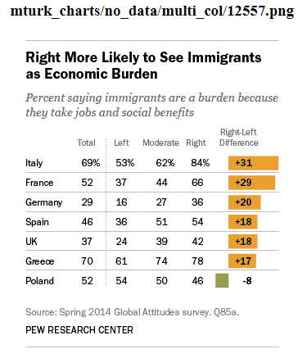
Too Complex
Among the seven nations surveyed, Greeks and Italians express particularly negative views about immigration. Eight-in-ten or more in both countries want less immigration, as do majorities in France and the UK. Public opinion is more closely divided in Spain, Germany and Poland, between those who want fewer immigrants admitted to their countries and those who say current levels should stay about the same. However, there is very little desire for allowing more immigrants in any of these seven nations – the percentage who hold this view ranges from 14% in Germany to only 1% in Greece.
(too complex since this chart is a table as opposed to a graph.)

Slide 23
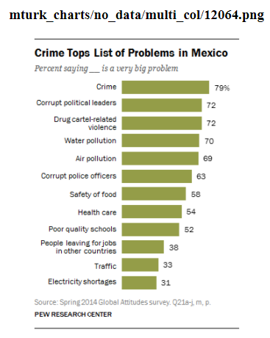
Good
About six-in-ten (58%) say food safety is a very big problem, and 54% say the same about health care. Roughly four-in-ten or fewer are troubled by people leaving for jobs in other countries (38%), traffic (33%) and electricity shortages (31%).

Slide 24
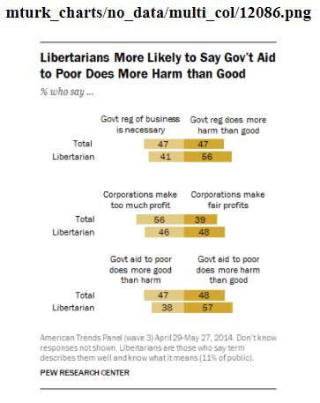
Good
When it comes to attitudes about the size and scope of government, people who say the term libertarian describes them well (and who are able to correctly define the term) are somewhat more likely than the public overall to say government regulation of business does more harm than good (56% vs. 47%). However, about four-in-ten libertarians say that government regulation of business is necessary to protect the public interest (41%).

Slide 25
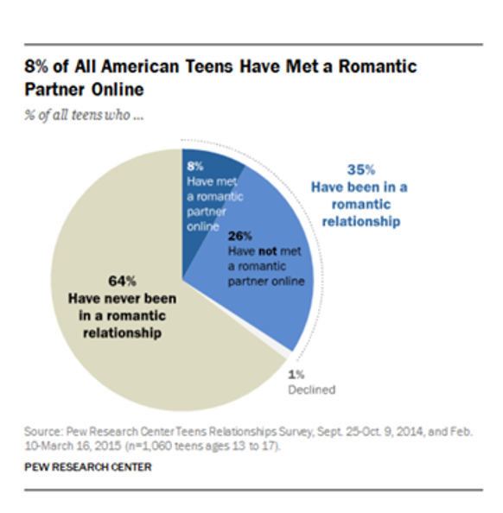
Sample QA
Good Example:
Question: How has social media affected teenage dating?
Answer: When it comes to meeting romantic partners, most teens do this offline. Only 8% of teens say they have met a romantic partner online.
Bad Example:
Question: What percent of American teens prefer meeting online?
Answer: In a study of 100,000 American teens, they found that 10% of teens have met a romantic partner online.
(Wrong since 100,000 American teens and 10% are not mentioned anywhere in the graph.)

Slide 26
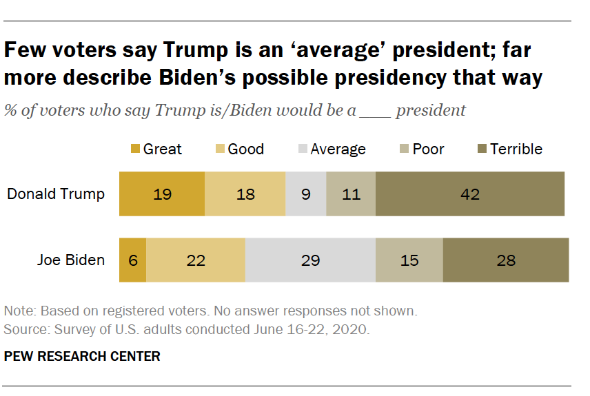
Sample QA
Good Example:
Question: What was the voters opinion about Trump ’s presidency ?
Answer: Very few voters – just 9 % – say Trump is an average president ; 37 % say he is a good or great president ; and a much larger share ( 53 % ) say he is poor or terrible , including 42 % who think he is a terrible president .
Bad Example:
Question: How many voters say Trump is an average president ?
Answer: 9%
(This is not a good example question because the answer is just a number as opposed to descriptive text.)

Slide 27
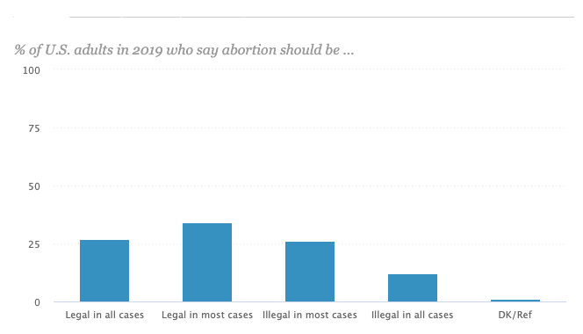
Sample QA
Good Example:
Question: What position do Americans hold on abortion?
Answer: Though abortion is a divisive issue, more than half of U.S. adults take a non-absolutist position, saying that in most – but not all – cases, abortion should be legal (34%) or illegal (26%). Fewer take the position that in all cases abortion should be either legal (27%) or illegal (12%).
Bad Example:
Question: Do most Americans think abortion should be Legal?
Answer: Yes
(This is not a good example question because the answer is just a single word as opposed to descriptive text.)

Slide 28
Baselines
Extractive :
Electra-https://github.com/google-research/electra
contextual info allowed in extractive summarisation
Model should know what to extract based on the question, and for contextual questions it should understand how the context is related
BertQA
Abstractive:
BART
T5
Document Grounded Generation

Slide 29
Annotation Process
Data Collection
dataset collection from pew
possibly collect from owid/oecd
Chart Filtering
categorizing into 'too complex’, 'good’, 'cannot make open ended question’
Annotation Study
Collecting questions and answers for each chart/summary pair according to rules
question check
check if question is open ended
check coherency, grammar
Disagreement Resolution
if one version is wrong choose correct version
take longest answer to next step if same answers from both workers
check percentage of words in smaller answer that appear in longer answer, and if above a certain percentage, use the longer answer
if both are wrong select the answer yourself from the summary
Decontextualization
removing info that is irrelevant to the question.(for now include info that is not derivable but is relevant)
add text that makes the sentence coherent
Dataset Analysis
Chart Type Classification
Question Type Classification

Slide 30
Instructions
Answer selection criteria
The answer should be at least one sentence long
It should provide a descriptive answer to the question asked. For example, ‘Describe the distribution of non-English speakers among immigrants of U.S?’ requires a textual description whereas ‘What percentage of immigrants speak Arabic?’ requires just a number as an answer.
The answer should not reference any knowledge outside the data represented in the chart.
Question creation criteria
The question should be open ended and require a descriptive answer
The descriptive answer of the chart should answer the question

Slide 31
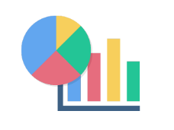
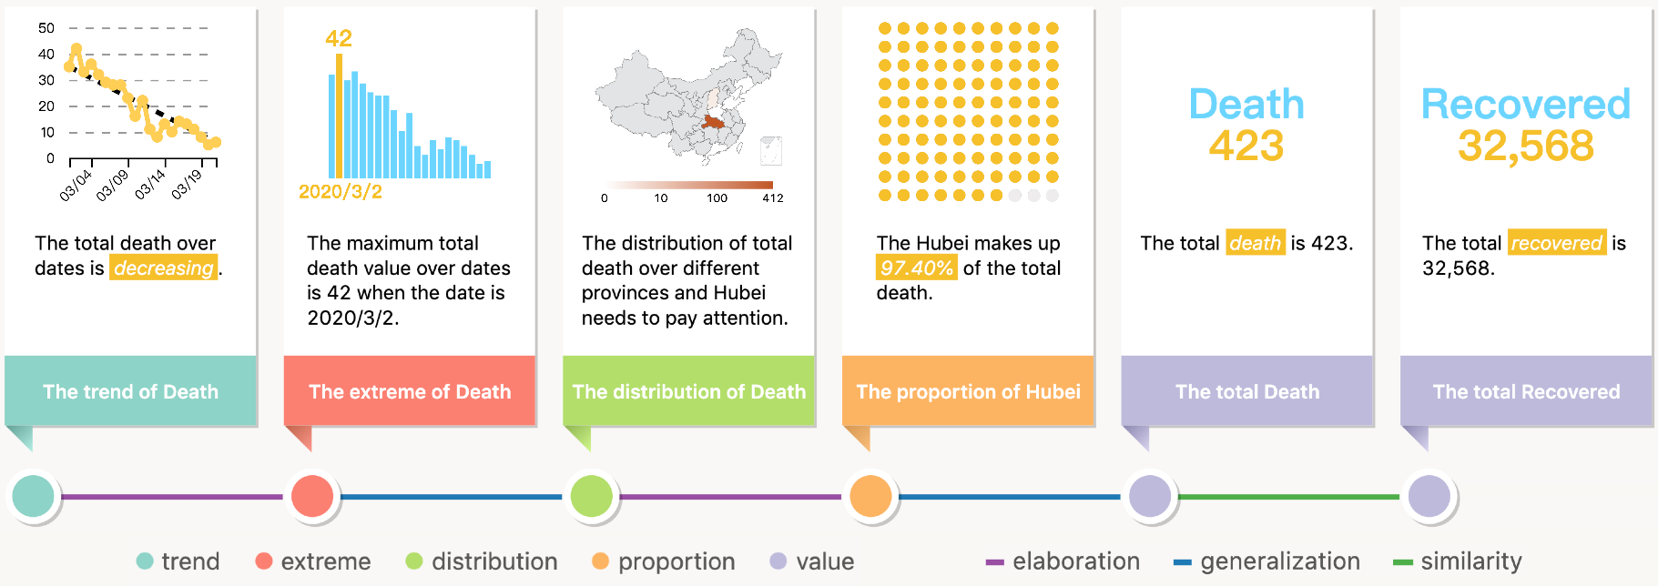
Task 4: Generating Visual Story
Visual story (a sequence of Text +Vis.)
Question and/or
No training data
Room for learning discourse/narrative structure
Shi et al, Vis 2020
https://www.youtube.com/watch?v=OufOfRXtGzk&feature=emb_logo

Slide 32
Low-level Tasks for Supporting Downstream Tasks
Task 1: Recover data and visual encodings
Often charts are in image format
Extracting data and visual encodings (how data maps to graphical marks of a chart) can improve tasks drastically
Task 2: Second order representation
Often downstream tasks involve arithmetic and logical operations
Representing logical and arithmetic relationships between data items can be helpful solving such tasks

Slide 33
Task 1: Recover Data and Visual Encodings
Computer Vision task in which the model predicts the underlying data table given a chart image in bitmap format.
Existing methods:
Visualizing for the non-visual
Low Accuracy mainly due to using object detection methods (predicts a bounding box)
Doesn’t generalize well to real-world data
ChartOCR
Very accurate predictions due to relying on key-point detection network.
SOTA on Real-world data
Doesn’t construct the full data table (no column or row names)
@Ahmed: Please add
- existing methods and their limitations
- list of datasets
- what are the main challenges? - object detection? OCR? Optimal matching?
- our plan for improved data extraction and optimal matching
- formal definition of the problem

Slide 34
Chart Data Extraction
Main Challenges
Object detection (solved)
OCR errors
Text role classification: Identify what are the legends.
AxisLabel – Legend – Value Matching
Our Plan
Propose a matching algorithm (maybe using optimal matching) to associate each value with its corresponding legend and axis labels.

Slide 35
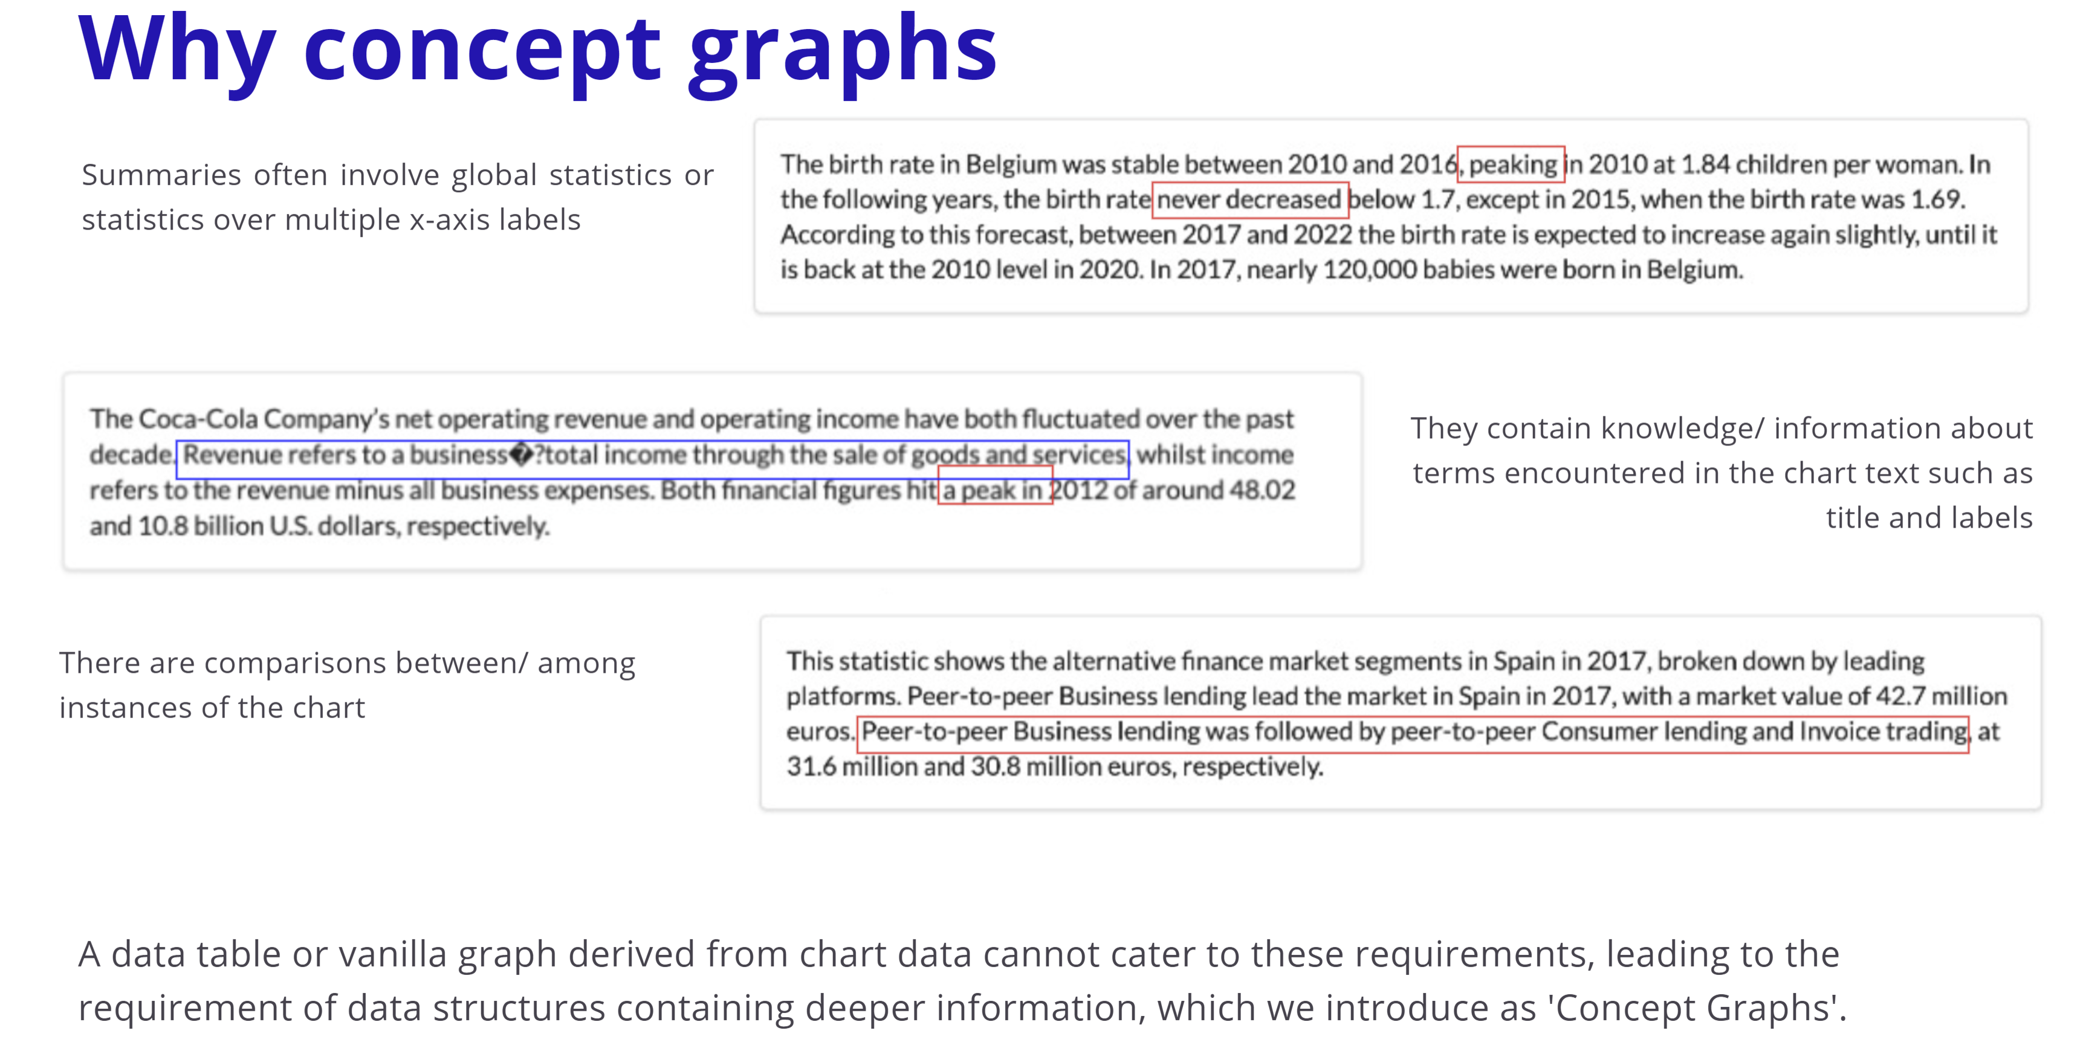
Second Order Representation
@Megh: Please add
- Why we need 2nd order representation?
- Literature review of existing work in other domains that do arithmetic/logical representation
- Possible ways to represent using knowledge graph with examples
- How the model can utilize such knowledge graph representation?
Datasets for experiments:
- Table Q/A datasets: e.g. WikiTQ
- Template qns for ChartQA that involves compositional operations

Slide 36
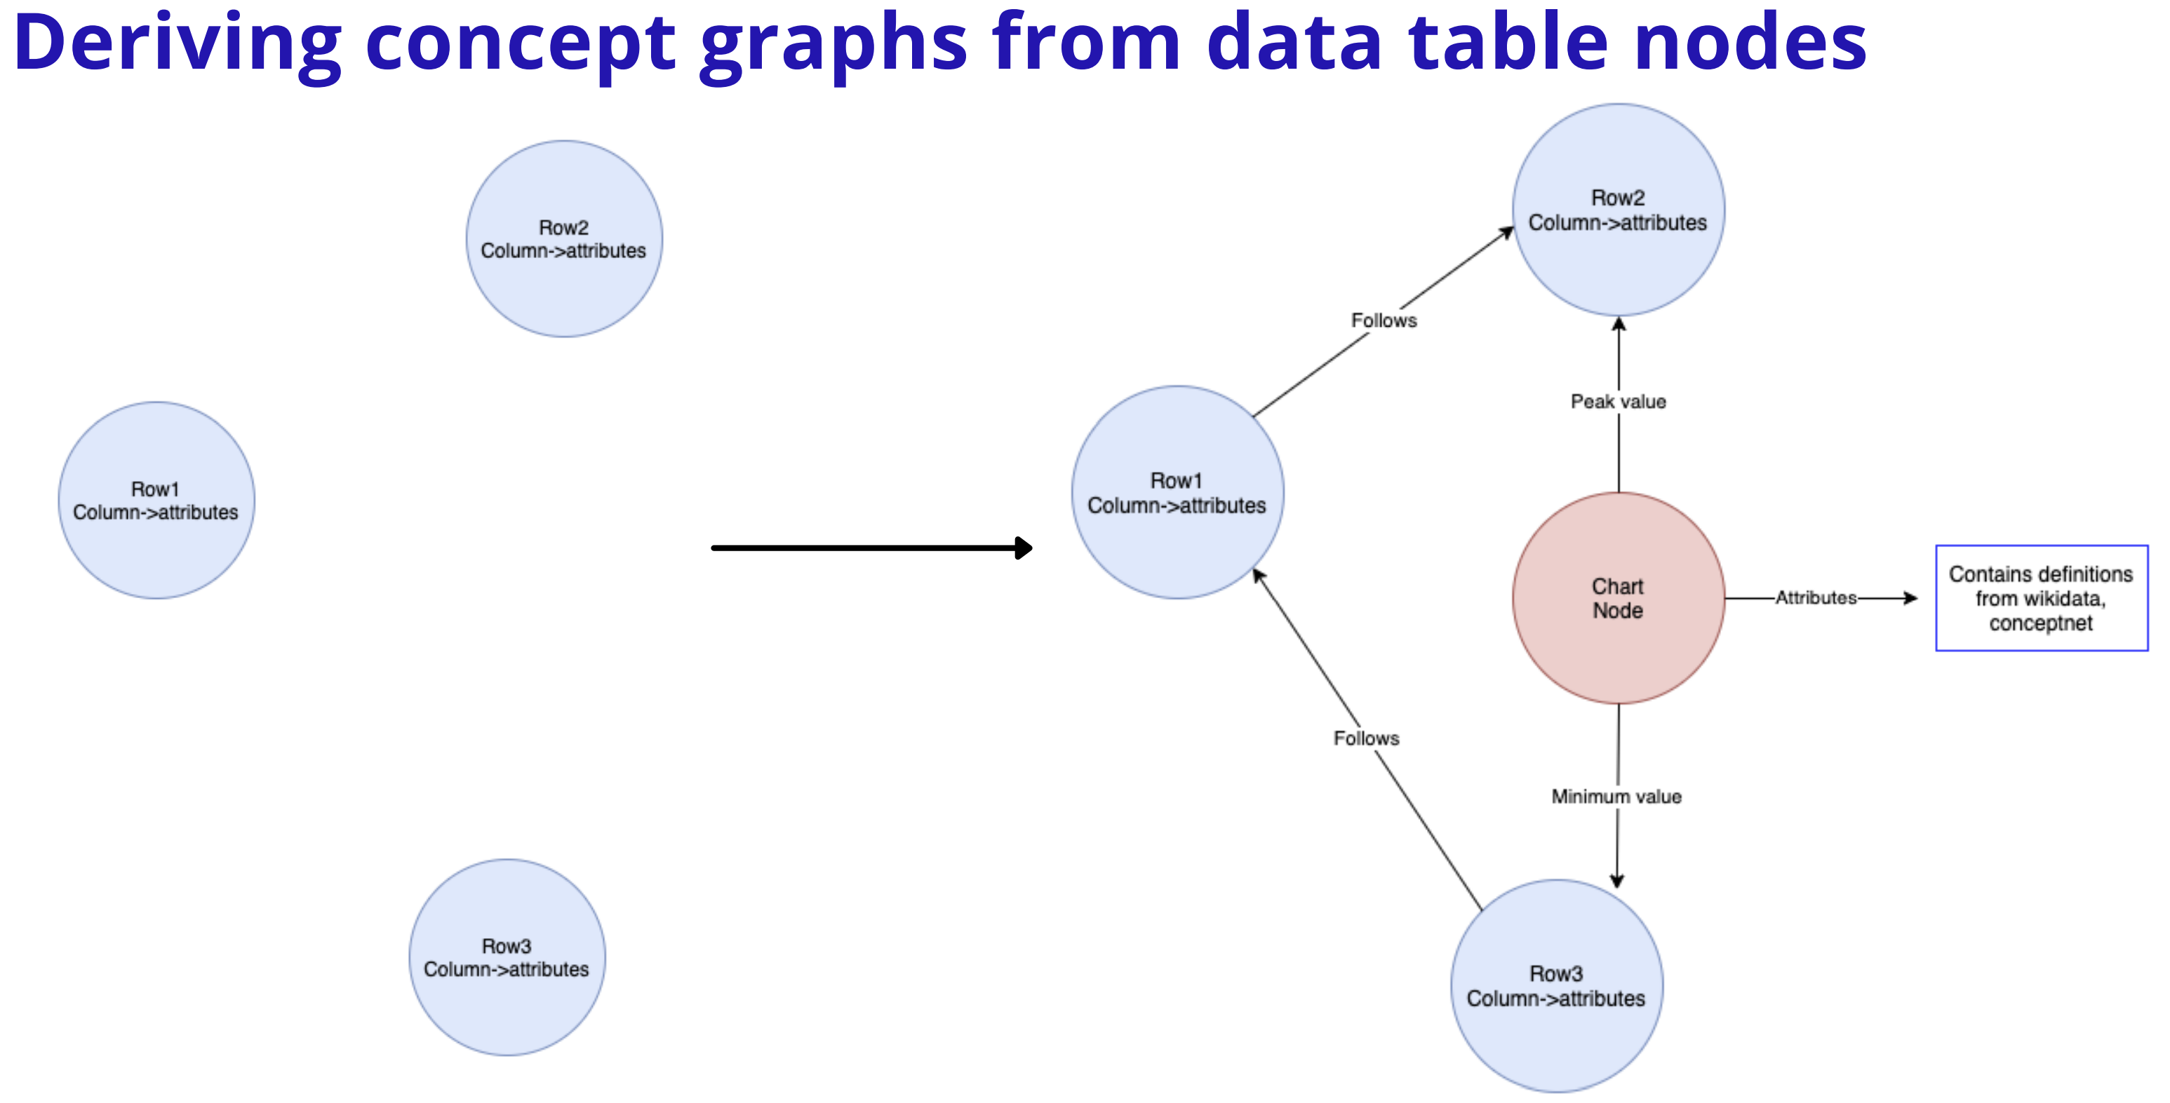
Second Order Representation

Slide 37
Short term objectives
Identify heuristics for generating rules and the graph
We could include visual attributes (e.g. color, length) for supporting questions with visual references.
Compare with other baselines that do not use graph representation.

Slide 38
Other Research Agenda
Common challenges
Factual correctness
Hallucination
Evaluation matrices such as ROUGE and BLEU are not sufficient for chart summarization
More automatic measures that capture the factual aspects and the hallucination problem are needed

Slide 39
Current Focuses
Low-level tasks
Task 1: Recover data and visual encodings (Chart-to-Data)
Task 2: Second order representation
Downstream tasks
Task 1: Generic summarization (Chart-to-text)
Task 2: Query focused summarization
Task 3: Factoid question answering

Slide 40
Extra slides (to delete)

Slide 41
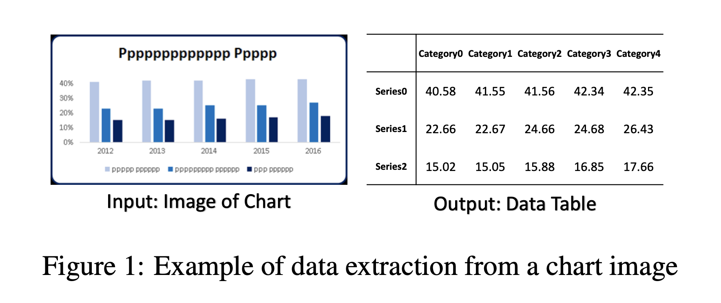
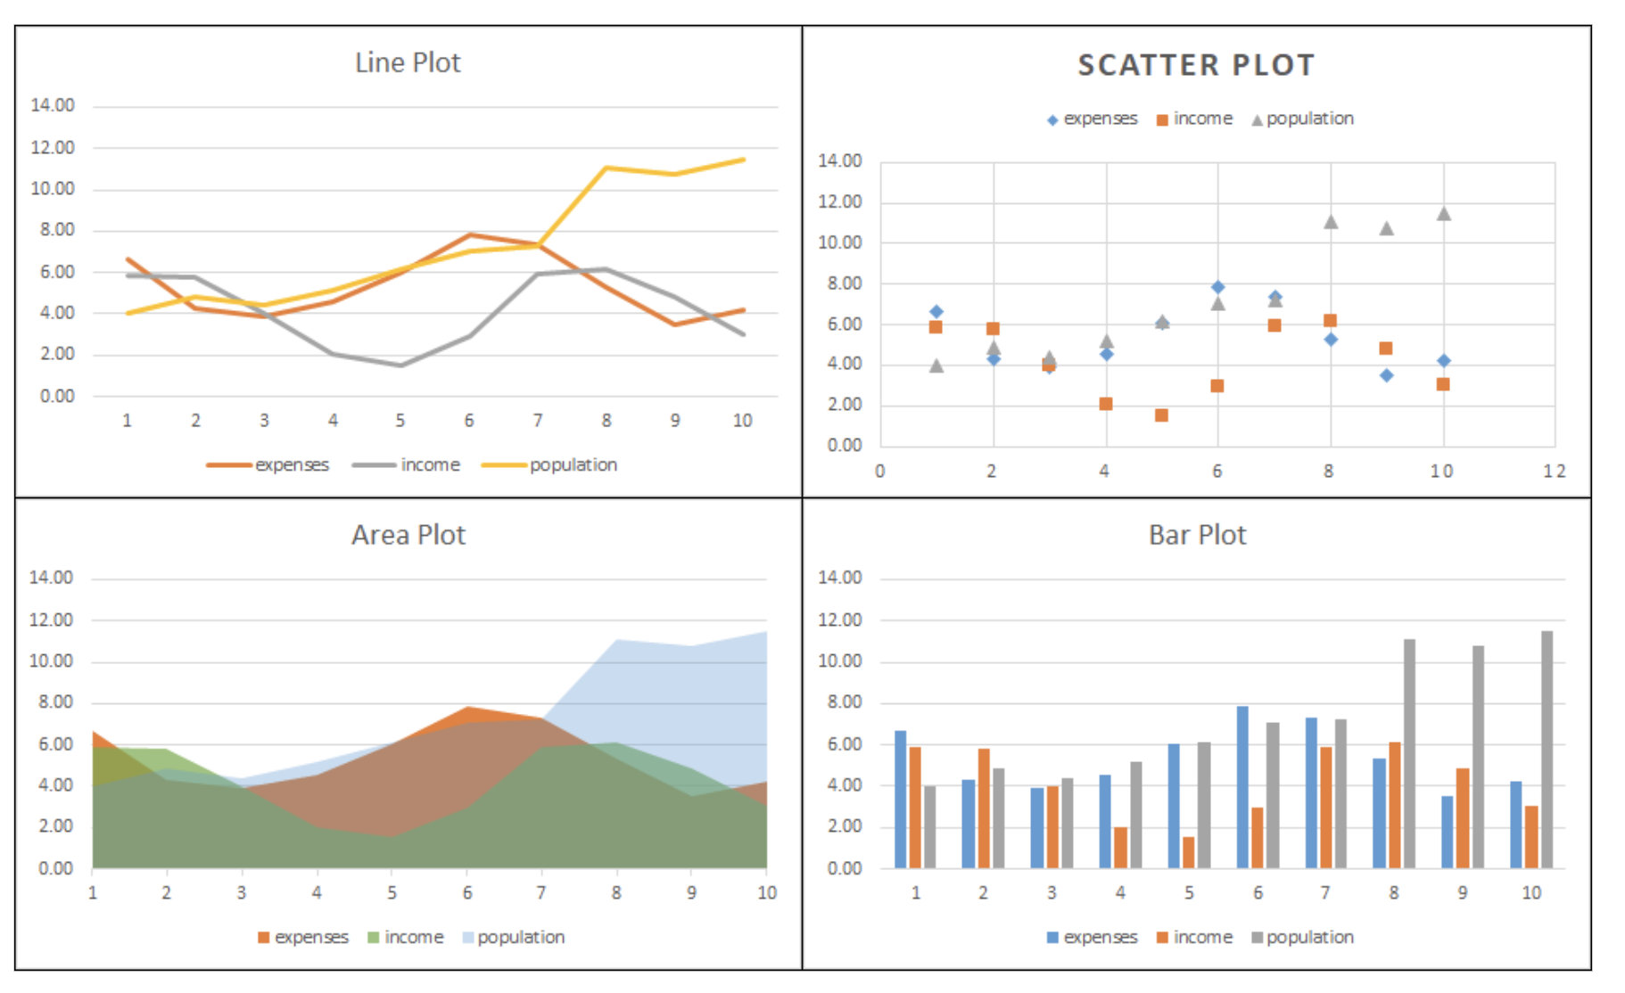
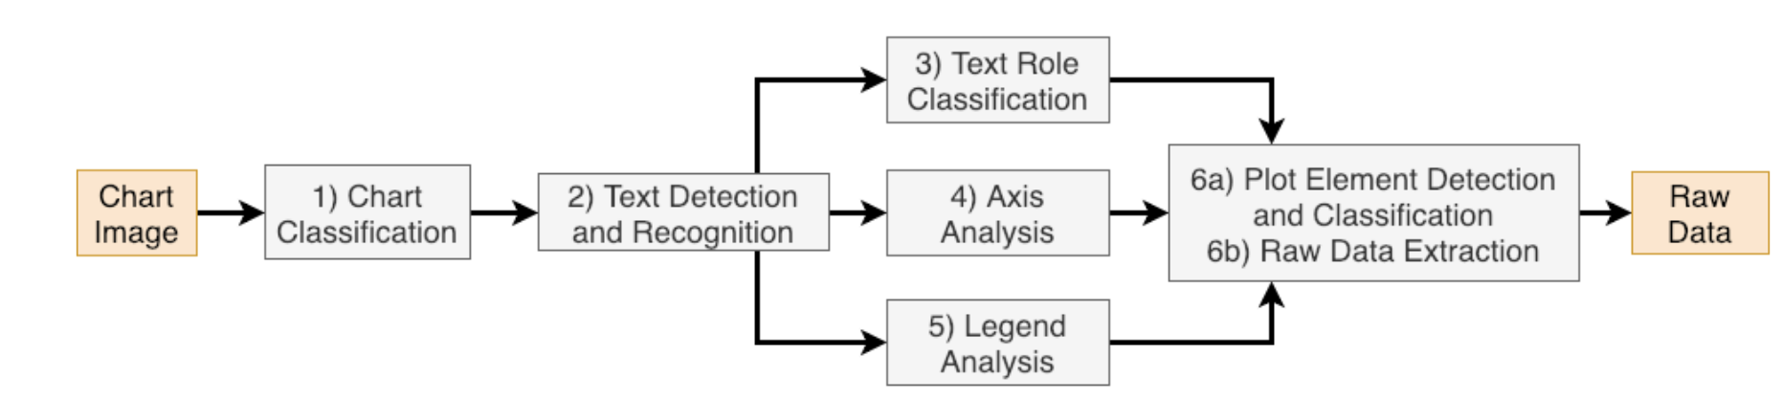
Image Chart Data Extraction
https://chartinfo.github.io/

Slide 42
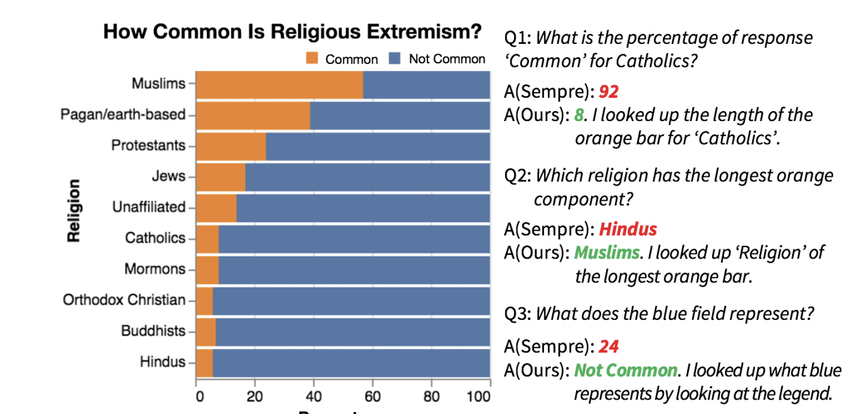
Chart question answering
Answering Questions about Charts and Generating Visual Explanations
Dae Hyun Kim, Enamul Hoque, Maneesh Agrawala, CHI 2020.

Slide 43
NL as input for Data Vis.
NL dialog interactions
Semantic similarities
Follow-up query (pragmatic)
No training dataset yet

Slide 44
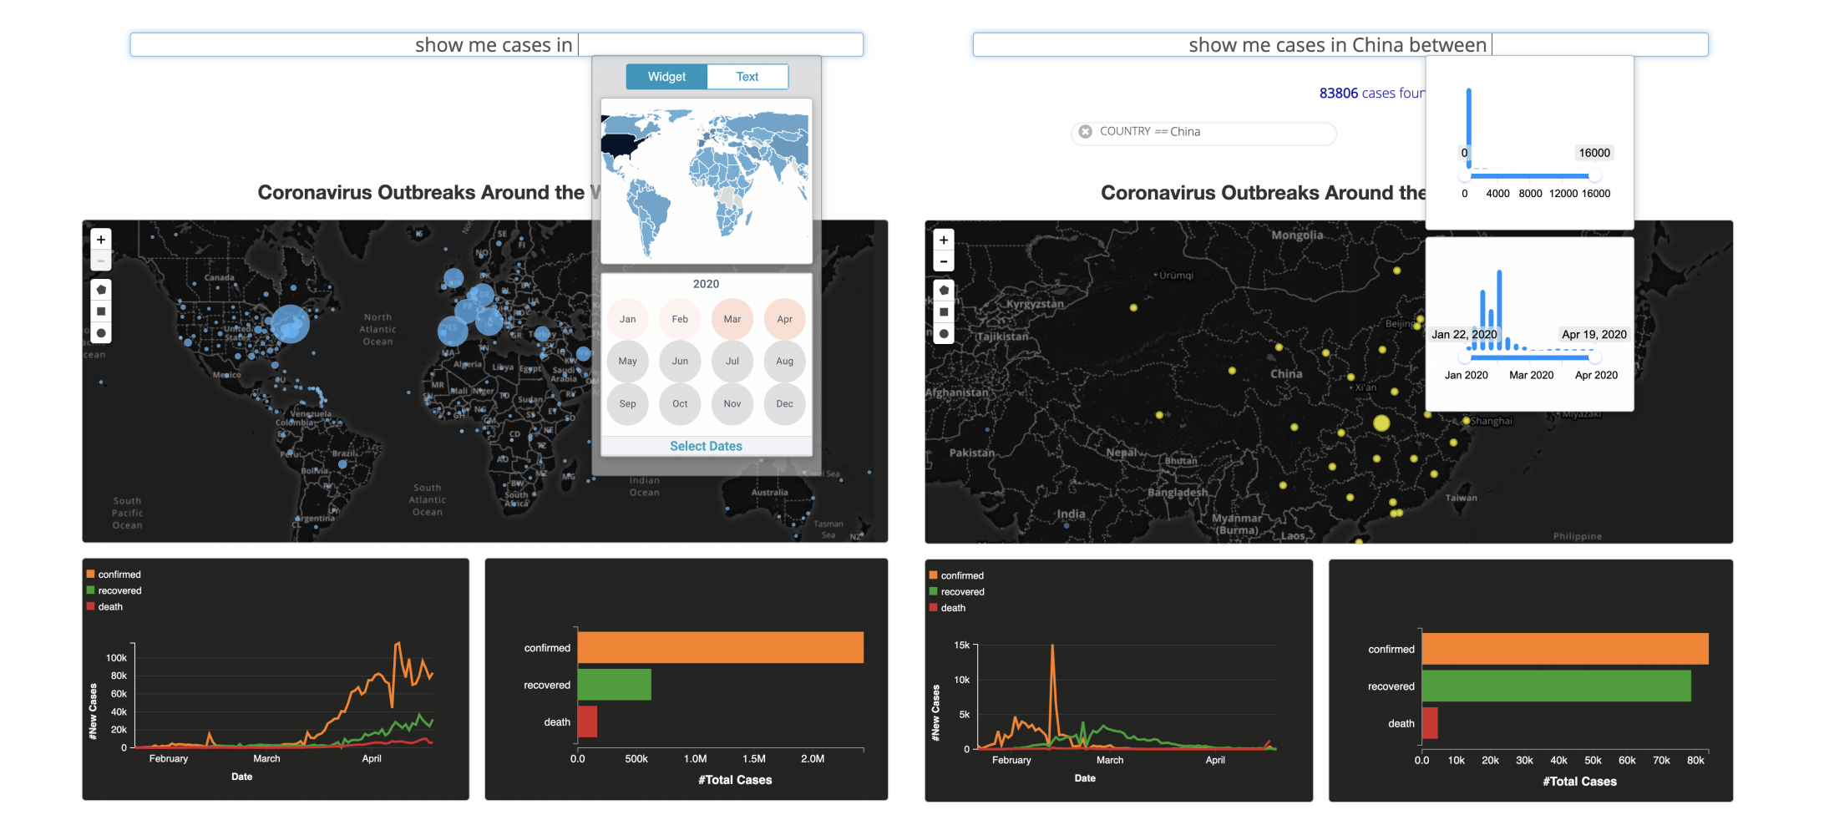
Combining NL and Viz as Input
Sneak Pique: Exploring Autocompletion as a Data Discovery Scaffold for Supporting Visual Analysis, Vidya Setlur, Enamul Hoque, Dae Hyun Kim, Angel Chang, UIST 2020

Slide 45
NLP as both input & output
Question/
Conversational q/a/
Multimodal (e.g speech, touch)
Text + Viz
Query focused summarization
No work has been done yet

